Slide 1


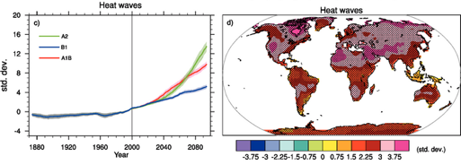

Background
Scope and purpose
Every year, tens of thousands of people die from exposure to extreme ambient heat (table 1).¹
The IPCC has projected trends of more frequent and longer-lasting heat waves, at higher than normal temperatures (figure 1).²
However, nearly all adverse health outcomes from extreme exposure are preventable.
‘Heat health’ is the term used to express the concept of the multiple dimensions which characterize the direct human health risks of ambient heat Exposure.
Scope and purpose
GHHIN addresses a two-fold problem:
the need to rapidly scale up efforts to manage the complex human health risks introduced by extreme and increasing ambient heat;
the need to harmonize and improve information and opportunity sharing across the burgeoning local communities of health professionals, scientists, and decision makers motivated to address the heat health issue.
GHHIN will improve the capacity of governments, organizations, and professionals to protect populations from the avoidable health risks of extreme ambient heat.
Scope and purpose
About GHHIN
Scope and purpose
GHHIN (pronounced ‘jin’), is an independent, voluntary, member-driven forum of scientists, health professionals, and decision makers.
GHHIN focuses on enhancing and multiplying the global and local learning and resilience-building for heat health.
Table 1. Top 10 extreme high temperature disasters and associated death toll by country and date (Source: http://www.emdat.be/)
Country | Date | Total Deaths
Russian Federation | June 2010 | 55,736
Italy | July 2003 | 20,089
France | August 2003 | 19,490
Spain | August 2003 | 15,090
Germany | August 2003 | 9,355
France | June 2015 | 3,275
Portugal | August 2003 | 2,696
India | May 1998 | 2,541
India | May 2015 | 2,248
France | July 2006 | 1,388
Fig. 1. Changes in extremes based on multi-model simulations from nine global coupled climate models, adapted from Tebaldi et al. (2006) for (c) Globally averaged changes in heat waves (defined as the longest period in the year of at least five consecutive days with maximum temperature at least 5°C higher than the climatology of the same calendar day). (d) Changes in spatial patterns of simulated heat waves between two 20-year means (2080–2099 minus 1980–1999) for the A1B scenario
Scope and purpose
Online heat hub resource (www.gghin.org).
Annual GHHIN forum (first meeting Februrary 2018 Bangkok TBC).
Biannual synthesis multi-disciplinary report of state of science and practice to monitor, predict, and address extreme heat risks.
Technical working groups
Formation of regional nodes
Outcomes and outputs
Scope and purpose
To help members in their own work in heat health by:
facilitating shared learning;
accelerating improvements in the global capacity to prepare for and respond to extreme heat.
Goal
Scope and purpose
To join our fast-growing growing network, get in touch with Joy Shumake-Guillemot, Officer-in-charge at the WHO/WMO Joint Office for Climate and Health at:
jshumake-guillemot@wmo.int
Contact
Acknowledgements GHHIN is supported and funded by …
References ⁽¹⁾ REFERENCE, ⁽²⁾ REFERENCE
^{www.environment-health.ac.uk}

